Slide 1

Cryptography and Network Security
Seventh Edition
by William Stallings
Notes:
Lecture slides prepared for “Cryptography and Network Security”, 7/e, by William Stallings, Chapter 4 – “Block Ciphers and the Data Encryption Standard”.

Slide 2
Chapter 4
Block Ciphers and the Data Encryption Standard
Notes:
The objective of this chapter is to illustrate the principles of modern symmetric
ciphers. For this purpose, we focus on the most widely used symmetric cipher: the Data
Encryption Standard (DES). Although numerous symmetric ciphers have been developed
since the introduction of DES, and although it is destined to be replaced by the
Advanced Encryption Standard (AES), DES remains the most important such algorithm.
Furthermore, a detailed study of DES provides an understanding of the principles
used in other symmetric ciphers.
This chapter begins with a discussion of the general principles of symmetric block
ciphers, which are the principal type of symmetric ciphers studied in this book. The
other form of symmetric ciphers, stream ciphers, are discussed in Chapter 8. Next, we
cover full DES. Following this look at a specific algorithm, we return to a more general
discussion of block cipher design.
Compared to public-key ciphers, such as RSA, the structure of DES and most
symmetric ciphers is very complex and cannot be explained as easily as RSA and similar
algorithms. Accordingly, the reader may wish to begin with a simplified version of
DES, which is described in Appendix G. This version allows the reader to perform
encryption and decryption by hand and gain a good understanding of the working of
the algorithm details. Classroom experience indicates that a study of this simplified
version enhances understanding of DES.
Several important symmetric block encryption algorithms in current use are based
on a structure referred to as a Feistel block cipher [FEIS73]. For that reason, it is
important to examine the design principles of the Feistel cipher. We begin with a
comparison of stream ciphers and block ciphers. Then we discuss the motivation for
the Feistel block cipher structure. Finally, we discuss some of its implications.

Slide 3
Cipher
Substitutions
Each plaintext element or group of elements is uniquely replaced by a corresponding ciphertext element or group of elements
No elements are added or deleted or replaced in the sequence, rather the order in which the elements appear in the sequence is changed
Permutation

Slide 4
XOR
Digital logic gate that gives a true output when the number of true inputs is odd. (XOR can also be viewed as addition modulo 2.)
Input |  | Output
A | B | A XOR B
0 | 0 | 0
0 | 1 | 1
1 | 0 | 1
1 | 1 | 0
Bitwise operations.
If you XOR some A value itself you will get 0 for each bit.
If C = A XOR B then:
B= A XOR C
A= B XOR C

Slide 5
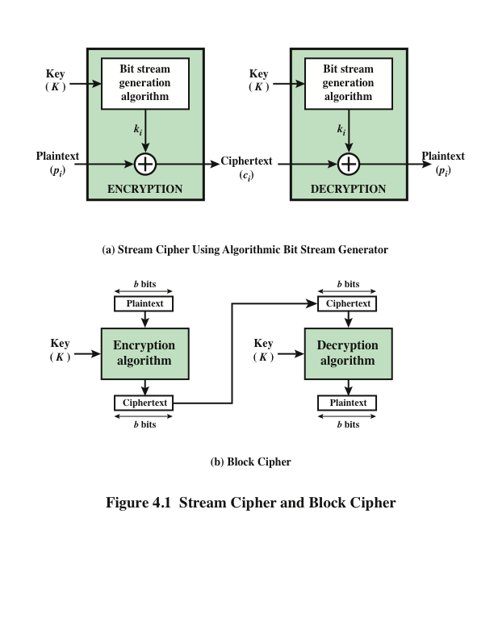
Notes:
Examples of stream and block ciphers.

Slide 6
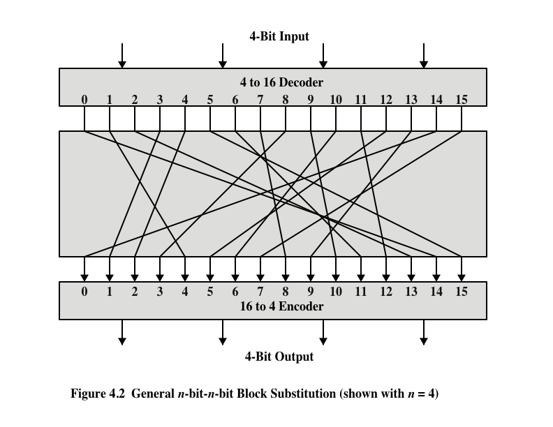
Notes:
A block cipher operates on a plaintext block of n bits to produce a ciphertext
block of n bits. There are 2^{n} possible different plaintext blocks and, for the
encryption to be reversible (i.e., for decryption to be possible), each must produce
a unique ciphertext block. Such a transformation is called reversible, or nonsingular.
Figure 4.2 illustrates the logic of a general substitution cipher for n = 4.
A 4-bit input produces one of 16 possible input states, which is mapped by the substitution
cipher into a unique one of 16 possible output states, each of which is represented
by 4 ciphertext bits.

Slide 7
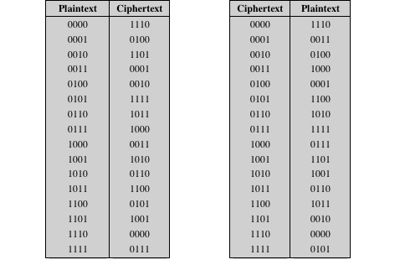
Table 4.1 Encryption and Decryption Tables for Substitution Cipher of Figure 4.2
Notes:
The encryption and decryption mappings can be defined
by a tabulation, as shown in Table 4.1. This is the most general form of block cipher
and can be used to define any reversible mapping between plaintext and ciphertext.
Feistel refers to this as the ideal block cipher , because it allows for the maximum
number of possible encryption mappings from the plaintext block [FEIS75].

Slide 8
Two important principles
Diffusion
The statistical structure of the plaintext is dissipated into long-range statistics of the ciphertext
This is achieved by having each plaintext digit affect the value of many ciphertext digits
Confusion
Seeks to make the relationship between the statistics of the ciphertext and the value of the encryption key as complex as possible
Even if the attacker can get some handle on the statistics of the ciphertext, the way in which the key was used to produce that ciphertext is so complex as to make it difficult to deduce the key
Notes:
The terms diffusion and confusion were introduced by
Claude Shannon to capture the two basic building blocks for any cryptographic
system [SHAN49]. Shannon’s concern was to thwart cryptanalysis based on statistical
analysis. The reasoning is as follows. Assume the attacker has some knowledge
of the statistical characteristics of the plaintext. For example, in a human-readable
message in some language, the frequency distribution of the various letters may be
known. Or there may be words or phrases likely to appear in the message (probable
words). If these statistics are in any way reflected in the ciphertext, the cryptanalyst
may be able to deduce the encryption key, part of the key, or at least a set of keys
likely to contain the exact key. In what Shannon refers to as a strongly ideal cipher,
all statistics of the ciphertext are independent of the particular key used. The arbitrary
substitution cipher that we discussed previously (Figure 4.2) is such a cipher,
but as we have seen, it is impractical.
Every block cipher involves a transformation of a block of plaintext into a
block of ciphertext, where the transformation depends on the key. The mechanism
of diffusion seeks to make the statistical relationship between the plaintext and
ciphertext as complex as possible in order to thwart attempts to deduce the key.
On the other hand, confusion seeks to make the relationship between the statistics of
the ciphertext and the value of the encryption key as complex as possible, again to
thwart attempts to discover the key. Thus, even if the attacker can get some handle
on the statistics of the ciphertext, the way in which the key was used to produce that
ciphertext is so complex as to make it difficult to deduce the key. This is achieved by
the use of a complex substitution algorithm. In contrast, a simple linear substitution
function would add little confusion.
As [ROBS95b] points out, so successful are diffusion and confusion in capturing
the essence of the desired attributes of a block cipher that they have become the
cornerstone of modern block cipher design.

Slide 9
Iterated Cipher
An iterated cipher requires the specification of a round function and a key schedule, and the encryption of a plaintext will proceed through N similar rounds.
The round function takes two inputs: Current state, w^{r-1} Key, K^{r} .
w⁰ is initial state
g is round function
K^{i} is round key.
N is the round number.
x,y are plaintext and ciphertext.

Slide 10
Iterated Cipher
In order decryption to be possible, the function must have the property that it is injective (i.e., one-to-one) if its second argument is fixed. That is:
g⁻¹ (g(w, y), y) = w for all w and y.

Slide 11
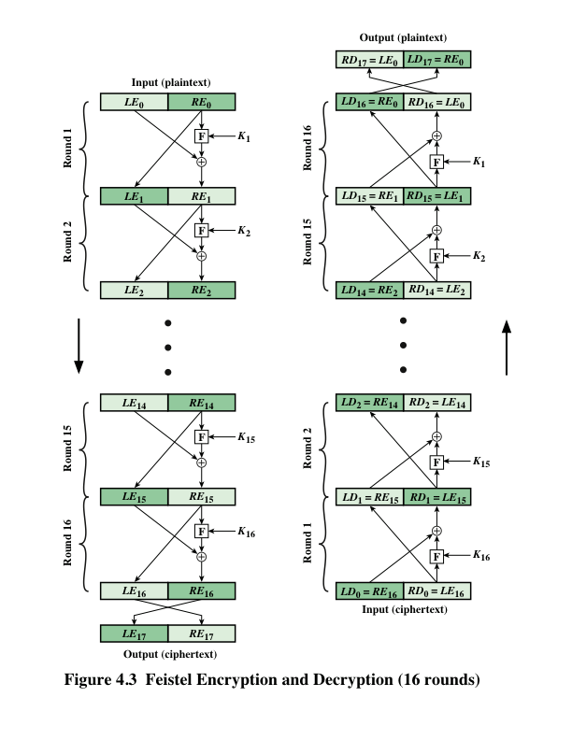
Feistel Cipher
A.k.a Feistel Network.
The round function g has the following form:
g(L_{i-1}, R_{i-1}, K_{i}) = (L_{i}, R_{i})
where:
L_{i}=R_{i-1}
R_{i}=L_{i-1} ⊕ f(R_{i-1} , K_{i})

Slide 12
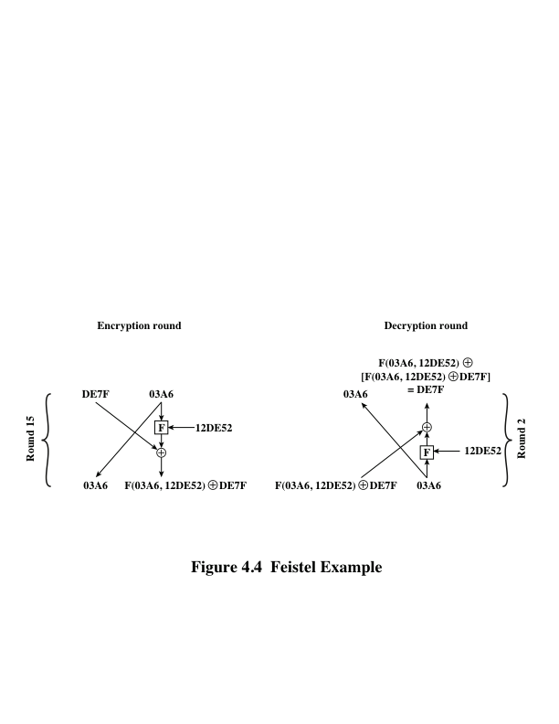
Feistel Example
After the last round you flip the output.
Notes:
The process of decryption with a Feistel cipher
is essentially the same as the encryption process. The rule is as follows: Use the
ciphertext as input to the algorithm, but use the subkeys K_{i} in reverse order. That
is, use K_{n} in the first round, K_{n-1} in the second round, and so on, until K₁ is used in
the last round. This is a nice feature, because it means we need not implement two
different algorithms; one for encryption and one for decryption.

Slide 13
Feistel Cipher Design Features
Block size
Larger block sizes mean greater security but reduced encryption/decryption speed for a given algorithm
Key size
Larger key size means greater security but may decrease encryption/decryption speeds
Number of rounds
The essence of the Feistel cipher is that a single round offers inadequate security but that multiple rounds offer increasing security
Subkey generation algorithm
Greater complexity in this algorithm should lead to greater difficulty of cryptanalysis
Round function F
Greater complexity generally means greater resistance to cryptanalysis
Notes:
The exact realization of a Feistel network depends on the choice of the following
parameters and design features:
• Block size: Larger block sizes mean greater security (all other things being
equal) but reduced encryption/decryption speed for a given algorithm. The
greater security is achieved by greater diffusion. Traditionally, a block size of
64 bits has been considered a reasonable tradeoff and was nearly universal in
block cipher design. However, the new AES uses a 128-bit block size.
• Key size: Larger key size means greater security but may decrease encryption/
decryption speed. The greater security is achieved by greater resistance to
brute-force attacks and greater confusion. Key sizes of 64 bits or less are now
widely considered to be inadequate, and 128 bits has become a common size.
• Number of rounds: The essence of the Feistel cipher is that a single round
offers inadequate security but that multiple rounds offer increasing security.
A typical size is 16 rounds.
• Subkey generation algorithm: Greater complexity in this algorithm should
lead to greater difficulty of cryptanalysis.
• Round function F: Again, greater complexity generally means greater resistance
to cryptanalysis.
We observe that the function f does not need to satisfy any type of injective.
You may have unbalanced cipher.

Slide 14
Data Encryption Standard (DES)
Issued in 1977 by the National Bureau of Standards (now NIST) as Federal Information Processing Standard 46
Was the most widely used encryption scheme until the introduction of the Advanced Encryption Standard (AES) in 2001
Algorithm :
Data are encrypted in 64-bit blocks using a 56-bit key
The algorithm transforms 64-bit input in a series of steps into a 64-bit output
The same steps, with the same key, are used to reverse the encryption
Notes:
Until the introduction of the Advanced Encryption Standard (AES) in 2001, the
Data Encryption Standard (DES) was the most widely used encryption scheme.
DES was issued in 1977 by the National Bureau of Standards, now the National
Institute of Standards and Technology (NIST), as Federal Information Processing
Standard 46 (FIPS PUB 46). The algorithm itself is referred to as the Data
Encryption Algorithm (DEA). For DEA, data are encrypted in 64-bit blocks using
a 56-bit key. The algorithm transforms 64-bit input in a series of steps into a 64-bit
output. The same steps, with the same key, are used to reverse the encryption.
Over the years, DES became the dominant symmetric encryption algorithm,
especially in financial applications. In 1994, NIST reaffirmed DES for federal use
for another five years; NIST recommended the use of DES for applications other
than the protection of classified information. In 1999, NIST issued a new version
of its standard (FIPS PUB 46-3) that indicated that DES should be used only for
legacy systems and that triple DES (which in essence involves repeating the DES
algorithm three times on the plaintext using two or three different keys to produce
the ciphertext) be used. We study triple DES in Chapter 7. Because the underlying
encryption and decryption algorithms are the same for DES and triple DES, it
remains important to understand the DES cipher. This section provides an overview.
For the interested reader, Appendix S provides further detail.

Slide 15
DES
56 bit initial key length,
8 bit parity, in total 64 bit.
Uses 48 bit keys for each round
Uses both permutation and substitution, for each round.

Slide 16
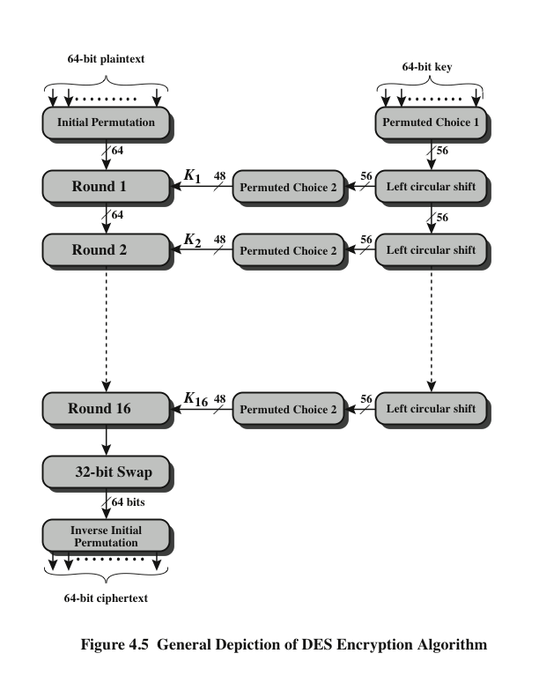
Notes:
The overall scheme for DES encryption is illustrated in Figure 4.5. As with any encryption
scheme, there are two inputs to the encryption function: the plaintext to be
encrypted and the key. In this case, the plaintext must be 64 bits in length and the
key is 56 bits in length.
Looking at the left-hand side of the figure, we can see that the processing
of the plaintext proceeds in three phases. First, the 64-bit plaintext passes through
an initial permutation (IP) that rearranges the bits to produce the permuted input .
This is followed by a phase consisting of sixteen rounds of the same function, which
involves both permutation and substitution functions. The output of the last (sixteenth)
round consists of 64 bits that are a function of the input plaintext and the
key. The left and right halves of the output are swapped to produce the preoutput .
Finally, the preoutput is passed through a permutation [IP ⁻¹ ] that is the inverse of
the initial permutation function, to produce the 64-bit ciphertext. With the exception
of the initial and final permutations, DES has the exact structure of a Feistel
cipher, as shown in Figure 4.3.
The right-hand portion of Figure 4.5 shows the way in which the 56-bit key is
used. Initially, the key is passed through a permutation function. Then, for each of
the sixteen rounds, a subkey (K_{i} ) is produced by the combination of a left circular
shift and a permutation. The permutation function is the same for each round, but a
different subkey is produced because of the repeated shifts of the key bits.
As with any Feistel cipher, decryption uses the same algorithm as encryption,
except that the application of the subkeys is reversed. Additionally, the initial and
final permutations are reversed.

Slide 17
DES
64 bit
64 bit
64 bit
Plaintext
broken
into 64
bit blocks
48 bit
Subkey
Initial Permutation
48 bit
32 bit
32 bit
Expanded
Left
Right
S-Box
Shrinked
32 bit
Permutation
Mangler Function
32 bit
32 bit
Left
Right
Round
Left
Right
Output
Permutation⁻¹
Ciphertext

Slide 18
DES Initial Permutation
Sample IP table:
46 | 25 | 42 | 34 | 26 | 18 | 10 | 2
60 | 52 | 44 | 36 | 28 | 20 | 12 | 4
62 | 54 | 58 | 38 | 30 | 22 | 14 | 6
64 | 56 | 48 | 40 | 32 | 24 | 16 | 8
57 | 49 | 41 | 33 | 50 | 17 | 9 | 1
59 | 51 | 43 | 7 | 27 | 19 | 11 | 3
61 | 53 | 45 | 37 | 29 | 21 | 13 | 5
63 | 55 | 47 | 39 | 31 | 23 | 15 | 35
This table specifies the input permutation on a 64-bit block.
The meaning is as follows:
- the first bit of the output is taken from the 46th bit of the input;
- the second bit from the 25th bit, and so on,
- with the last bit of the output taken from the 35th bit of the input.

Slide 19
DES S-Box
011011
S₅ |  | Middle 4 bits of input
 |  | 0000 | 0001 | 0010 | 0011 | 0100 | 0101 | 0110 | 0111 | 1000 | 1001 | 1010 | 1011 | 1100 | 1101 | 1110 | 1111
Outer bits | 00 | 0010 | 1100 | 0100 | 0001 | 0111 | 1010 | 1011 | 0110 | 1000 | 0101 | 0011 | 1111 | 1101 | 0000 | 1110 | 1001
 | 01 | 1110 | 1011 | 0010 | 1100 | 0100 | 0111 | 1101 | 0001 | 0101 | 0000 | 1111 | 1010 | 0011 | 1001 | 1000 | 0110
 | 10 | 0100 | 0010 | 0001 | 1011 | 1010 | 1101 | 0111 | 1000 | 1111 | 1001 | 1100 | 0101 | 0110 | 0011 | 0000 | 1110
 | 11 | 1011 | 1000 | 1100 | 0111 | 0001 | 1110 | 0010 | 1101 | 0110 | 1111 | 0000 | 1001 | 1010 | 0100 | 0101 | 0011

Slide 20
DES Key
16*48 bit Subkeys
48 bit
Initial Key
48 bit
10010010…
Permutation 56 bit shift
48 bit
11110010…
10000010…
8 bit
Parity
…
10011110…
Every 8 bit has a parity bit. Odd number.

Slide 21
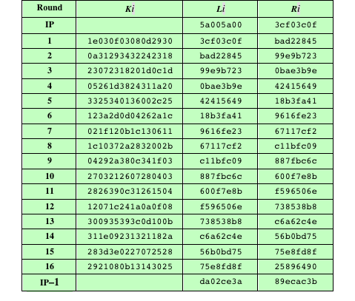
Table 4.2 DES Example
(Table can be found on page 114 in textbook)
Note: DES subkeys are shown as eight 6-bit values in hex format
Notes:
We now work through an example and consider some of its implications. Although
you are not expected to duplicate the example by hand, you will find it informative
to study the hex patterns that occur from one step to the next.
For this example, the plaintext is a hexadecimal palindrome. The plaintext,
key, and resulting ciphertext are as follows:
Plaintext: 02468aceeca86420
Key: 0f1571c947d9e859
Ciphertext: da02ce3a89ecac3b
Table 4.2 shows the progression of the algorithm. The first row shows the 32-bit
values of the left and right halves of data after the initial permutation. The next 16
rows show the results after each round. Also shown is the value of the 48-bit subkey
generated for each round. Note that L_{i} = R_{i-1} . The final row shows the left- and
right-hand values after the inverse initial permutation. These two values combined
form the ciphertext.

Slide 22
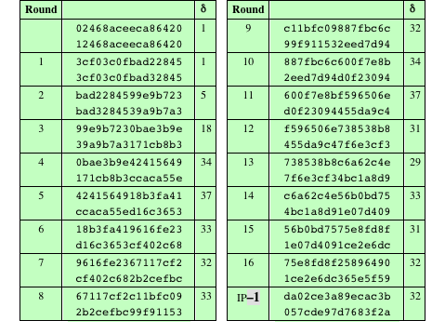
Table 4.3 Avalanche Effect in DES: Change in Plaintext
12468aceeca86420
Notes:
A desirable property of any encryption algorithm is that a small change in either
the plaintext or the key should produce a significant change in the ciphertext. In
particular, a change in one bit of the plaintext or one bit of the key should produce
a change in many bits of the ciphertext. This is referred to as the avalanche effect. If
the change were small, this might provide a way to reduce the size of the plaintext
or key space to be searched.
Using the example from Table 4.2, Table 4.3 shows the result when the fourth
bit of the plaintext is changed, so that the plaintext is 12468aceeca86420 . The
second column of the table shows the intermediate 64-bit values at the end of each
round for the two plaintexts. The third column shows the number of bits that differ
between the two intermediate values. The table shows that, after just three rounds,
18 bits differ between the two blocks. On completion, the two ciphertexts differ in
32 bit positions.

Slide 23
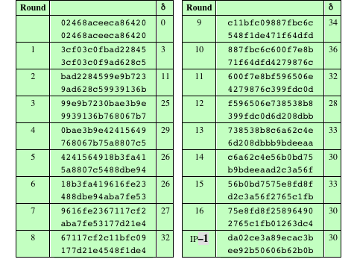
Table 4.4 Avalanche Effect in DES: Change in Key
0f1571c947d9e859
1f1571c947d9e859
Notes:
Table 4.4 shows a similar test using the original plaintext of with two keys that
differ in only the fourth bit position: the original key, 0f1571c947d9e859 , and
the altered key, 1f1571c947d9e859 . Again, the results show that about half of
the bits in the ciphertext differ and that the avalanche effect is pronounced after just
a few rounds.

Slide 24
Strength of DES
Discussions on two topics
56 bit key length
With a key length of 56 bits, there are 2^56 possible keys, which is approximately 7.2 * 10^16 keys.
brute-force attack appears impractical.
DES encryption per microsecond would take more than a thousand years
Parallel computing makes it possible.
*1000000 makes it 10 HRS
Nature of the algorithm
S-boxes
Not public

Slide 25
Table 4.5 Average Time Required for Exhaustive Key Search
Key Size (bits) | Number of Alternative Keys | Time required at 1 decryption/µs | Time required at 10⁶ decryptions/µs
32 | 2³² = 4.3 × 10⁹ | 2³¹ µs = 35.8 minutes | 2.15 milliseconds
56 | 2⁵⁶ = 7.2 × 10¹⁶ | 2⁵⁵ µs = 1142 years | 10.01 hours
128 | 2¹²⁸ = 3.4 × 10³⁸ | 2¹²⁷ µs = 5.4 × 10²⁴ years | 5.4 × 10¹⁸ years
168 | 2¹⁶⁸ = 3.7 × 10⁵⁰ | 2¹⁶⁷ µs = 5.9 × 10³⁶ years | 5.9 × 10³⁰ years
26 characters (permutation) | 26! = 4 × 10²⁶ | 2 × 10²⁶ µs = 6.4 × 10¹² years | 6.4 × 10⁶ years
Notes:
Since its adoption as a federal standard, there have been lingering concerns about
the level of security provided by DES. These concerns, by and large, fall into two
areas: key size and the nature of the algorithm.
With a key length of 56 bits, there are 2⁵⁶ possible keys, which is approximately
7.2 * 10¹⁶ keys. Thus, on the face of it, a brute-force attack appears impractical.
Assuming that, on average, half the key space has to be searched, a single machine
performing one DES encryption per microsecond would take more than a thousand
years to break the cipher.
However, the assumption of one encryption per microsecond is overly conservative.
As far back as 1977, Diffie and Hellman postulated that the technology
existed to build a parallel machine with 1 million encryption devices, each of which
could perform one encryption per microsecond [DIFF77]. This would bring the
average search time down to about 10 hours. The authors estimated that the cost
would be about $20 million in 1977 dollars.
With current technology, it is not even necessary to use special, purpose-built
hardware. Rather, the speed of commercial, off-the-shelf processors threaten the
security of DES. A recent paper from Seagate Technology [SEAG08] suggests that
a rate of 1 billion (10⁹ ) key combinations per second is reasonable for today’s multicore
computers. Recent offerings confirm this. Both Intel and AMD now offer
hardware-based instructions to accelerate the use of AES. Tests run on a contemporary
multicore Intel machine resulted in an encryption rate of about half a billion
encryptions per second [BASU12]. Another recent analysis suggests that with
contemporary supercomputer technology, a rate of 10¹³ encryptions per second is
reasonable [AROR12].
With these results in mind, Table 4.5 shows how much time is required for
a brute-force attack for various key sizes. As can be seen, a single PC can break
DES in about a year; if multiple PCs work in parallel, the time is drastically shortened.
And today’s supercomputers should be able to find a key in about an hour.
Key sizes of 128 bits or greater are effectively unbreakable using simply a brute-force
approach. Even if we managed to speed up the attacking system by a factor
of 1 trillion (10¹² ), it would still take over 100,000 years to break a code using a
128-bit key.
Fortunately, there are a number of alternatives to DES, the most important of
which are AES and triple DES, discussed in Chapters 6 and 7, respectively.

Slide 26
Block Cipher Design Principles: Number of Rounds
The greater the number of rounds, the more difficult it is to perform cryptanalysis
In general, the criterion should be that the number of rounds is chosen so that known cryptanalytic efforts require greater effort than a simple brute-force key search attack
If DES had 15 or fewer rounds, differential cryptanalysis would require less effort than a brute-force key search
Notes:
The cryptographic strength of a Feistel cipher derives from three aspects of the
design: the number of rounds, the function F, and the key schedule algorithm. Let
us look first at the choice of the number of rounds.

Slide 27
Block Cipher Design Principles: Number of Rounds
The greater the number of rounds, the more difficult it is to perform cryptanalysis,
even for a relatively weak F.
In general, the criterion should be that the number is chosen so that known cryptanalytic efforts require greater effort than a simple brute-force key search attack.
16-round DES, a differential cryptanalysis attack is slightly less efficient than brute force: The differential cryptanalysis attack requires 2^{55.1} operations, whereas brute force requires 2⁵⁵ .
If DES had 15 or fewer rounds, differential cryptanalysis would require less effort than a brute-force key search.
Notes:
The greater the number of rounds, the more difficult it is to perform cryptanalysis,
number of round even for a relatively weak F. In general, the criterion should be that the
ds is chosen so that known cryptanalytic efforts require greater
effort than a simple brute-force key search attack. This criterion was certainly used
in the design of DES. Schneier [SCHN96] observes that for 16-round DES, a differential
cryptanalysis attack is slightly less efficient than brute force: The differential
cryptanalysis attack requires 2^{55.1} operations, whereas brute force requires 2⁵⁵ . If
DES had 15 or fewer rounds, differential cryptanalysis would require less effort
than a brute-force key search.
This criterion is attractive, because it makes it easy to judge the strength of
an algorithm and to compare different algorithms. In the absence of a cryptanalytic
breakthrough, the strength of any algorithm that satisfies the criterion can be
judged solely on key length.

Slide 28
Block Cipher Design Principles: Design of Function F
Strict avalanche criterion (SAC)
States that any output bit j of an S-box should change with probability 1/2 when any single input bit i is inverted for all i , j
Bit independence criterion (BIC)
States that output bits j and k should change independently when any single input bit i is inverted for all i , j , and k
The heart of a Feistel block cipher is the function F
The more nonlinear F, the more difficult any type of cryptanalysis will be
The SAC and BIC criteria appear to strengthen the effectiveness of the confusion function
The algorithm should have good
avalanche properties
Notes:
The heart of a Feistel block cipher is the function F, which provides the element
of confusion in a Feistel cipher. Thus, it must be difficult to “unscramble” the
substitution performed by F. One obvious criterion is that F be nonlinear, as we
discussed previously. The more nonlinear F, the more difficult any type of cryptanalysis
will be. There are several measures of nonlinearity, which are beyond
the scope of this book. In rough terms, the more difficult it is to approximate F
by a set of linear equations, the more nonlinear F is.
Several other criteria should be considered in designing F. We would like the
algorithm to have good avalanche properties. Recall that, in general, this means that
a change in one bit of the input should produce a change in many bits of the output.
A more stringent version of this is the strict avalanche criterion (SAC) [WEBS86],
which states that any output bit j of an S-box (see Appendix S for a discussion of
S-boxes) should change with probability 1/2 when any single input bit i is inverted
for all i , j . Although SAC is expressed in terms of S-boxes, a similar criterion could
be applied to F as a whole. This is important when considering designs that do not
include S-boxes.
Another criterion proposed in [WEBS86] is the bit independence criterion
(BIC) , which states that output bits j and k should change independently when any
single input bit i is inverted for all i , j , and k . The SAC and BIC criteria appear to
strengthen the effectiveness of the confusion function.

Slide 29
Block Cipher Design Principles: Key Schedule Algorithm
With any Feistel block cipher, the key is used to generate one subkey for each round
In general, we would like to select subkeys to maximize the difficulty of deducing individual subkeys and the difficulty of working back to the main key
It is suggested that, at a minimum, the key schedule should guarantee key/ciphertext Strict Avalanche Criterion and Bit Independence Criterion
Notes:
With any Feistel block cipher, the key is used to generate one subkey for each
round. In general, we would like to select subkeys to maximize the difficulty of
deducing individual subkeys and the difficulty of working back to the main key. No
general principles for this have yet been promulgated.
Adams suggests [ADAM94] that, at minimum, the key schedule should
guarantee key/ciphertext Strict Avalanche Criterion and Bit Independence
Criterion.

Slide 30
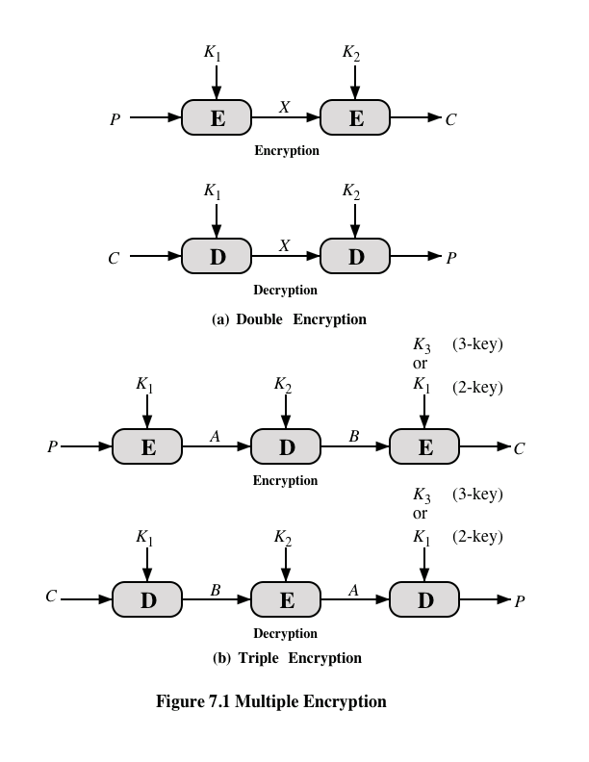
Notes:
Because of its vulnerability to brute-force attack, DES, once the most widely used
symmetric cipher, has been largely replaced by stronger encryption schemes. Two
approaches have been taken. One approach is to design a completely new algorithm
that is resistant to both cryptanalytic and brute-force attacks, of which AES
is a prime example. Another alternative, which preserves the existing investment in
software and equipment, is to use multiple encryption with DES and multiple keys.
We begin by examining the simplest example of this second alternative. We then
look at the widely accepted triple DES (3DES) algorithm.
The simplest form of multiple encryption has two encryption stages and two keys
(Figure 7.1a).
Given a plaintext P and two encryption keys K₁ and K₂ , ciphertext C
is generated as
C = E(K₂ , E(K₁ , P ))
Decryption requires that the keys be applied in reverse order:
P = D(K₁ , D(K₂ , C ))
For DES, this scheme apparently involves a key length of 56 * 2 = 112 bits, resulting
in a dramatic increase in cryptographic strength. But we need to examine the
algorithm more closely.
it is reasonable to assume that if DES is used twice with different keys, it
will produce one of the many mappings that are not defined by a single application
of DES. Although there was much supporting evidence for this assumption, it was
not until 1992 that the assumption was proven [CAMP92].

Slide 31
Meet-in-the-Middle Attack
X = E(K1, P) = D(K2, C)
The use of double DES results in a mapping that is not equivalent to a single DES encryption
The meet-in-the-middle attack algorithm will attack this scheme and does not depend on any particular property of DES but will work against any block encryption cipher
Notes:
Thus, the use of double DES results in a mapping
that is not equivalent to a single DES encryption. But there is a way to attack this
scheme, one that does not depend on any particular property of DES but that will
work against any block encryption cipher.
The algorithm, known as a meet-in-the-middle attack , was first described in
[DIFF77].
Given a known pair, (P, C), the attack proceeds as follows. First, encrypt P for all
256 possible values of K1. Store these results in a table and then sort the table by the
values of X. Next, decrypt C using all 256 possible values of K2. As each decryption
is produced, check the result against the table for a match. If a match occurs, then
test the two resulting keys against a new known plaintext–ciphertext pair. If the two
keys produce the correct ciphertext, accept them as the correct keys.

Slide 32
Triple-DES with Two-Keys
Obvious counter to the meet-in-the-middle attack is to use three stages of encryption with three different keys
This raises the cost of the meet-in-the-middle attack to 2¹¹², which is beyond what is practical
Has the drawback of requiring a key length of 56 x 3 = 168 bits, which may be somewhat unwieldy
As an alternative Tuchman proposed a triple encryption method that uses only two keys
3DES with two keys is a relatively popular alternative to DES and has been adopted for use in the key management standards ANSI X9.17 and ISO 8732
Notes:
An obvious counter to the meet-in-the-middle attack is to use three stages of encryption
with three different keys. This raises the cost of the meet-in-the-middle attack
to 2¹¹² , which is beyond what is practical now and far into the future. However, it
has the drawback of requiring a key length of 56 * 3 = 168 bits, which may be
somewhat unwieldy.
As an alternative, Tuchman proposed a triple encryption method that uses
only two keys [TUCH79].
3DES with two keys is a relatively popular alternative to DES and has been
adopted for use in the key management standards ANSI X9.17 and ISO 8732.1

Slide 33
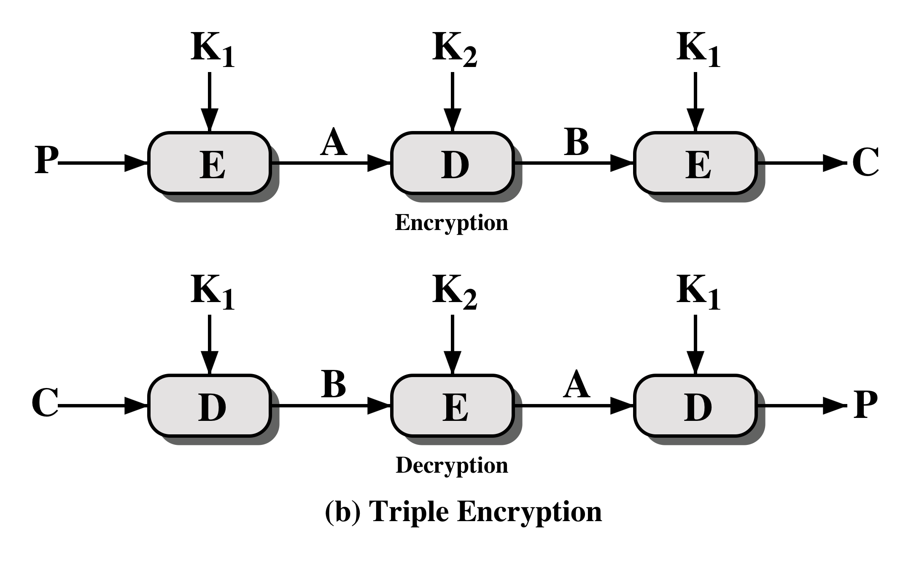
Notes:
The first serious proposal came from Merkle and Hellman [MERK81]. Their
plan involves finding plaintext values that produce a first intermediate value of
A = 0 (Figure 7.1b) and then using the meet-in-the-middle attack to determine
the two keys. The level of effort is 2⁵⁶ , but the technique requires 2⁵⁶ chosen plaintext–
ciphertext pairs, which is a number unlikely to be provided by the holder of
the keys.
A known-plaintext attack is outlined in [VANO90]. This method is an improvement
over the chosen-plaintext approach but requires more effort. The attack
is based on the observation that if we know A and C (Figure 7.1b), then the problem
reduces to that of an attack on double DES. Of course, the attacker does not know
A , even if P and C are known, as long as the two keys are unknown. However, the
attacker can choose a potential value of A and then try to find a known (P , C ) pair
that produces A .

Slide 34
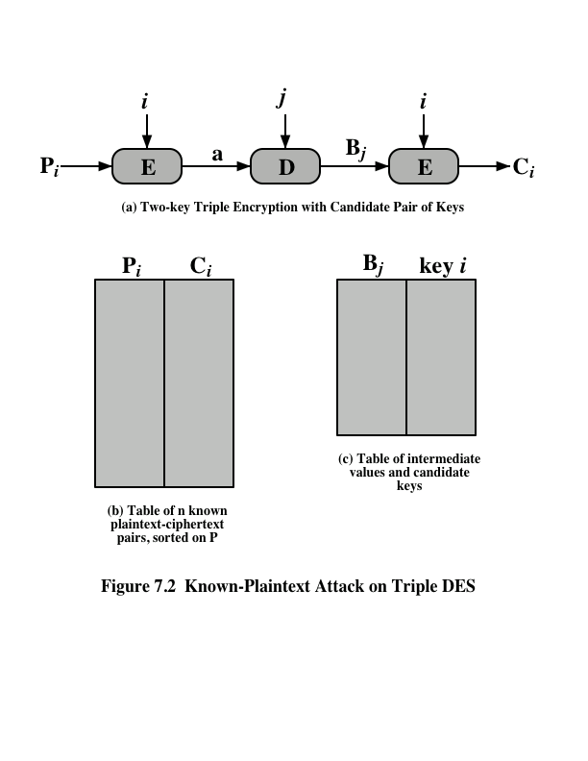
Notes:
The attack proceeds as follows.
1. Obtain n (P , C ) pairs. This is the known plaintext. Place these in a table
(Table 1) sorted on the values of P (Figure7.2b).
2. Pick an arbitrary value a for A, and create a second table (Figure 6.2c) with entries
defined in the following fashion. For each of the 2⁵⁶ possible keys K₁ = i,
calculate the plaintext value P_{i} that produces a:
P_{i} = D(i, a)
For each P_{i} that matches an entry in Table 1, create an entry in Table 2 consisting
of the K₁ value and the value of B that is produced for the (P, C) pair from
Table 1, assuming that value of K₁:
B = D(i, C)
At the end of this step, sort Table 2 on the values of B.
3. We now have a number of candidate values of K₁ in Table 2 and are in a position
to search for a value of K₂. For each of the 2⁵⁶ possible keys K₂ = j, calculate
the second intermediate value for our chosen value of a:
B_{j} = D(j, a)
At each step, look up B_{j} in Table 2. If there is a match, then the corresponding
key i from Table 2 plus this value of j are candidate values for the unknown
keys (K₁, K₂). Why? Because we have found a pair of keys (i, j) that produce a
known (P, C) pair (Figure 7.2a).
4. Test each candidate pair of keys (i, j) on a few other plaintext–ciphertext
pairs. If a pair of keys produces the desired ciphertext, the task is complete. If
no pair succeeds, repeat from step 1 with a new value of a.
For a given known (P , C ), the probability of selecting the unique value of a
that leads to success is 1/2⁶⁴ . Thus, given n (P , C ) pairs, the probability of success for
a single selected value of a is n /2⁶⁴ .

Slide 35
Triple DES with Three Keys
Many researchers feel that three-key 3DES is the preferred alternative
A number of Internet-based applications have adopted three-key 3DES including PGP and S/MIME
Three-key 3DES has an effective key length of 168 bits and is defined as:
C = E( K₃, D( K₂, E( K₁, P)))
Backward compatibility with DES is provided by putting:
K₃ = K₂ or K₁ = K₂
Notes:
Although the attacks just described appear impractical, anyone using two-key 3DES
may feel some concern. Thus, many researchers feel that three-key 3DES is
the preferred alternative (e.g., [KALI96a]). Three-key 3DES has an effective key
length of 168 bits and is defined as
C = E( K₃, D( K₂, E( K₁, P)))
Backward compatibility with DES is provided by putting
K₃ = K₂ or K₁ = K₂
A number of Internet-based applications have adopted three-key 3DES, including
PGP and S/MIME, both discussed in Chapter 19.

